Slide 1
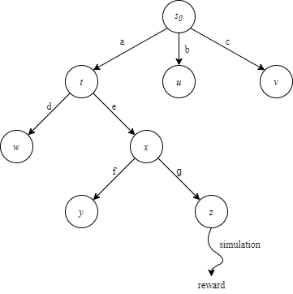
Automated Quantum Circuit Design with Monte Carlo Tree Search
Peiyong Wang

Slide 2
Motivation
An automated protocol for designing quantum circuits/ansatz without any heuristic for the problem;
With tree-based method, constraints can be directly applied by pruning the unwanted nodes from the operation pool, instead of just adding a penalty term on the loss and/or reward function(s);
Make it possible to develop quantum circuits tailored to the hardware topology

Slide 3
Related Research
Differentiable quantum ansatz search, which assumes the choice of operations in each layer follows a probability distribution. A popular choice is the independent categorical probability distribution [1];
Quantum architecture search with subnets uniformly sampled from a supernet and ranked by their performance. Parameters are shared among different subnets [2];
QAS with a neural predictor, which is trained with the structure of different circuits and their performance, and can predict the performance of a searched architecture without evaluation [3];
QAS with deep reinforcement learning. Instead of following a probability distribution, a reinforcement learning agent is trained for selecting the operations in the circuit [4];
QAS with meta-learning. The proposed meta quantum architecture search (MetaQAS) algorithm aims to learn a meta-architecture α_{meta} as well as meta-parameters of quantum gates θ_{meta} from a set of training tasks drawn from a distribution over tasks p(T ) that we want our algorithm to be able to adapt to [5].

Slide 4
Contribution
We are the first to apply tree-based method to quantum circuit search;
MCTS enables us to search through larger search space;
Instead of just choosing from the entire operation pool at each layer then using a penalty function to increase the loss of circuit with unwanted snippets (e.g. two neighbouring Pauli X gates), with our tree-based search algorithm, we can just rule out those unwanted operations when checking the legal actions of each node.

Slide 5
Monte-Carlo Tree Search
A heuristic search algorithm designed for (sequential) decision problem, e.g. given a initial quantum state, and a target state that we want to prepare, how do we assign quantum operations at different locations of the circuit to reach the target state;
Vanilla MCTS includes four stages:
Selection, expansion, simulation and backpropagation.

Slide 6
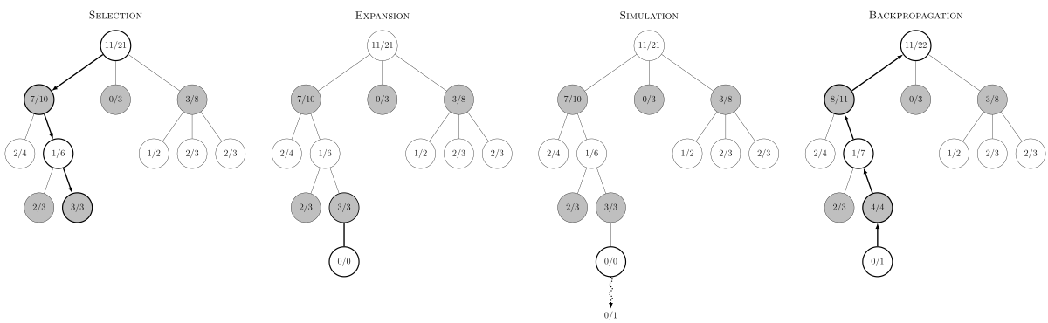
Monte-Carlo Tree Search
Source: Wikipedia

Slide 7
Nested MCTS
However, even MCTS can sometimes struggle with large branch factors, like when playing RTS games (C&C, StarCraft, etc..), there could be tens of thousands of different possible choices at each state.
Nested Monte Carlo tree search was developed to deal with this kind of problems [6].
In nested MCTS, before choosing which action to take, we first run the four-stage MCTS multiple times to update the rewards of each action, then we make the selection according to some policy

Slide 8
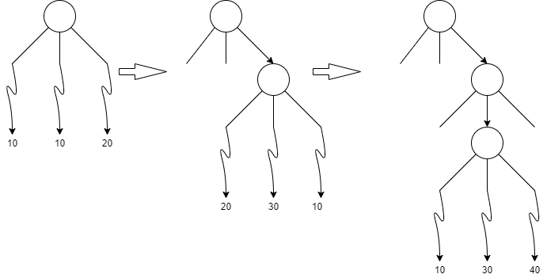
Nested MCTS

Slide 9
Naïve Assumption
We also borrowed the concept of “naïve assumption” from combinatorial multi-armed bandits [7]. With naïve assumption, we treat the selection of operations at each layer of the circuit as a local multi-armed bandit, and the selection of different circuit structure as a global multi-armed bandit, and the reward for global MAB is a linear function of the local MABs. Since we can calculate the reward of a circuit (global MAB) with the pre-defined loss/reward function, then we can just assign the reward of the global MAB to the selected actions of each local MAB, then take the average with respect to the number of times the corresponding action has been taken. Then we can prune the children nodes if the average reward of the children node is smaller than a certain percentage of the reward of the parent node.

Slide 10
QAS with MCTS
Tree Node (circle in right figure): Contains the information of current state, children nodes and parent node, whether it is fully expanded or not. The current state contains the information about the list of operations that has already been added to the circuit, functions to check legal actions and take actions, and whether current state is terminal state (i.e. reached the maximum number of layers);
Straight arrows: actions leading to the corresponding child;
Single round of execution: starting from the root (or a given node), select an action according to some policy if the node is fully expanded, or expand the node by randomly choose a new action, repeat until terminal state reached. Then perform the simulation to obtain reward, and backpropagate the reward back to each node on the arc;

Slide 11
QAS with MCTS
Sampling (search) and exploiting: At each iteration of the searching process, a batch of circuit will be sampled from the tree. When sampling, firstly we’ll perform the single round execution at the node multiple times, then perform the rollout stage of MCTS following some policy. When exploiting, starting from the root, we’ll perform single round execution multiple times at each node of the arc, then select the action according to some policy. After the batch of arcs being sampled, simulation will be run to obtain rewards, and the rewards will be backpropagated;
Warm up: When search for parameterized circuits, sometimes warm up of the parameters may be required. At each iteration of warm up stage, the sampling will be random sampling at each node. The rest is the same as the searching stage;

Slide 12
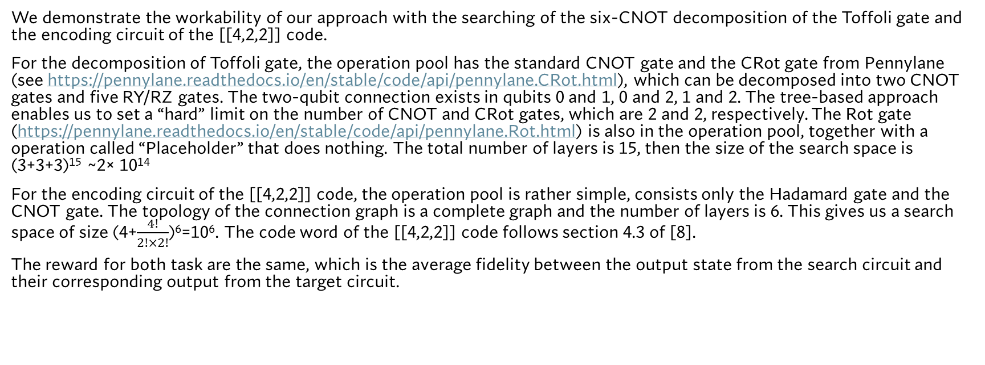
Toffoli Gate and [[4,2,2]] Code
We demonstrate the workability of our approach with the searching of the six-CNOT decomposition of the Toffoli gate and the encoding circuit of the [[4,2,2]] code.
For the decomposition of Toffoli gate, the operation pool has the standard CNOT gate and the CRot gate from Pennylane (see https://pennylane.readthedocs.io/en/stable/code/api/pennylane.CRot.html), which can be decomposed into two CNOT gates and five RY/RZ gates. The two-qubit connection exists in qubits 0 and 1, 0 and 2, 1 and 2. The tree-based approach enables us to set a “hard” limit on the number of CNOT and CRot gates, which are 2 and 2, respectively. The Rot gate (https://pennylane.readthedocs.io/en/stable/code/api/pennylane.Rot.html) is also in the operation pool, together with a operation called “Placeholder” that does nothing. The total number of layers is 15, then the size of the search space is (3+3+3)¹⁵ ~2× 10¹⁴
For the encoding circuit of the [[4,2,2]] code, the operation pool is rather simple, consists only the Hadamard gate and the CNOT gate. The topology of the connection graph is a complete graph and the number of layers is 6. This gives us a search space of size (4+$\frac{4!}{2!×2!}$)⁶=10⁶. The code word of the [[4,2,2]] code follows section 4.3 of [8].
The reward for both task are the same, which is the average fidelity between the output state from the search circuit and their corresponding output from the target circuit.

Slide 13
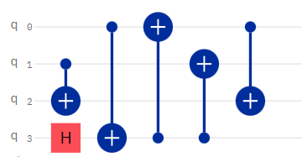
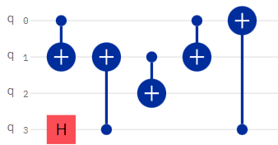
Results for [[4,2,2]] code
For the searching of the encoding circuit of the [[4,2,2]] code, we ran the program two times with the same hyper-parameters. Due to different random seeds settings, we obtained the following two circuits, and verified that they can indeed perform the required tasks:

Slide 14
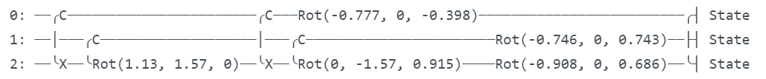
Result for CCX Decomposition
For the decomposition of Toffoli gate, our search algorithm returns a circuit with two CNOT gates, two CRot gates and three Rot gates :

Slide 15
Result for CCX Decomposition
Initial State | Initial State Vector | Searched Circuit Output | CCX Output
000 | [1, 0, 0, 0, 0, 0, 0, 0] | [0.7647+0.6444j, 0, 0, 0, 0, 0, 0, 0] | [1, 0, 0, 0, 0, 0, 0, 0]
001 | [0, 1, 0, 0, 0, 0, 0, 0] | [0, 0.8876+0.4607j, 0, 0, 0, 0, 0, 0] | [0, 1, 0, 0, 0, 0, 0, 0]
010 | [0, 0, 1, 0, 0, 0, 0, 0] | [ 0, 0, 9.4739e-01-3.2009e-01j, -8.4365e-09-3.2526e-09j, 0, 0, 0, 0] | [0, 0, 1, 0, 0, 0, 0, 0]
011 | [0, 0, 0, 1, 0, 0, 0, 0] | [0, 0, 6.2744e-09+6.5104e-09j, 7.3074e-02+9.9733e-01j, 0, 0, 0, 0] | [0, 0, 0, 1, 0, 0, 0, 0]
100 | [0, 0, 0, 0, 1, 0, 0, 0] | [0, 0, 0, 0, 0.8892-0.4575j, 0, 0, 0] | [0, 0, 0, 0, 1, 0, 0, 0]
101 | [0, 0, 0, 0, 0, 1, 0, 0] | [0, 0, 0, 0, 0, 0.767-0.6417j, 0, 0] | [0, 0, 0, 0, 0, 1, 0, 0]
110 | [0, 0, 0, 0, 0, 0, 1, 0] | [0, 0, 0, 0, 0, 0, -4.9726e-09+1.9376e-09j, -9.4853e-01-3.1670e-01j] | [0, 0, 0, 0, 0, 0, 0, 1]
111 | [0, 0, 0, 0, 0, 0, 0, 1] | [0, 0, 0, 0, 0, 0, 6.9510e-02-9.9758e-01j, -3.6896e-09+3.8558e-09j] | [0, 0, 0, 0, 0, 0, 1, 0]

Slide 16
Result for CCX Decomposition (after setting small values to zero)
Initial State | Initial State Vector | Searched Circuit Output | CCX Output
000 | [1, 0, 0, 0, 0, 0, 0, 0] | [0.7647+0.6444j, 0, 0, 0, 0, 0, 0, 0] | [1, 0, 0, 0, 0, 0, 0, 0]
001 | [0, 1, 0, 0, 0, 0, 0, 0] | [0, 0.8876+0.4607j, 0, 0, 0, 0, 0, 0] | [0, 1, 0, 0, 0, 0, 0, 0]
010 | [0, 0, 1, 0, 0, 0, 0, 0] | [ 0, 0, 9.4739e-01-3.2009e-01j, 0, 0, 0, 0, 0] | [0, 0, 1, 0, 0, 0, 0, 0]
011 | [0, 0, 0, 1, 0, 0, 0, 0] | [0, 0, 0, 7.3074e-02+9.9733e-01j, 0, 0, 0, 0] | [0, 0, 0, 1, 0, 0, 0, 0]
100 | [0, 0, 0, 0, 1, 0, 0, 0] | [0, 0, 0, 0, 0.8892-0.4575j, 0, 0, 0] | [0, 0, 0, 0, 1, 0, 0, 0]
101 | [0, 0, 0, 0, 0, 1, 0, 0] | [0, 0, 0, 0, 0, 0.767-0.6417j, 0, 0] | [0, 0, 0, 0, 0, 1, 0, 0]
110 | [0, 0, 0, 0, 0, 0, 1, 0] | [0, 0, 0, 0, 0, 0, 0, -9.4853e-01-3.1670e-01j] | [0, 0, 0, 0, 0, 0, 0, 1]
111 | [0, 0, 0, 0, 0, 0, 0, 1] | [0, 0, 0, 0, 0, 0, 6.9510e-02-9.9758e-01j, 0] | [0, 0, 0, 0, 0, 0, 1, 0]

Slide 17
Ref
[1] S.-X. Zhang, C.-Y. Hsieh, S. Zhang, and H. Yao, Differentiable quantum architecture search (2020), arXiv:2010.08561 [quant-ph].
[2] Y. Du, T. Huang, S. You, M.-H. Hsieh, and D. Tao, Quantum circuit architecture search: error mitigation and trainability enhancement for variational quantum solvers (2020), arXiv:2010.10217 [quant-ph].
[3] S.-X. Zhang, C.-Y. Hsieh, S. Zhang, and H. Yao, Neural predictor based quantum architecture search (2021), arXiv:2103.06524 [quant-ph].
[4] E.-J. Kuo, Y.-L. L. Fang, and S. Y.-C. Chen, Quantum architecture search via deep reinforcement learning (2021), arXiv:2104.07715 [quant-ph].
[5] C. Chen, Z. He, L. Li, S. Zheng, and H. Situ, Quantum architecture search with meta-learning (2021), arXiv:2106.06248 [quant-ph].
[6] T. Cazenave, Nested monte-carlo search, in Proceedings of the 21st International Joint Conference on Artificial Intelligence, IJCAI'09 (Morgan Kaufmann Publishers Inc., San Francisco, CA, USA, 2009) p. 456-461.
[7] S. Ontanon, The combinatorial multi-armed bandit problem and its application to real-time strategy games, in Proceedings of the Ninth AAAI Conference on Artificial Intelligence and Interactive Digital Entertainment, AIIDE’ 13 (AAAI Press, 2013) p. 58~64
[8] J. Roffe, Quantum error correction: an introductory guide, Contemporary Physics60, 226–245 (2019)

